Slide 1
THE RISE OF China and its implications for ASEAN
CKS/HSEPP/ZAMAN UNIVERSITY LECTURE BY dr Benny Widyono

Slide 2
THE THREE TECTONIC POWER SHIFTS IN ECONOMIC GLOBALIZATION
I. The Rise of the West
2. The rise of the US
3. The Rise of China
Notes:
OVER THE LAST FIVE HUNDRED YEARS OR SO, THERE HAVE BEEN THREE TECTONIC POWER SHIFTS WHICH BROUGHT ABOUT FUNDAMENTAL CHANGES IN THE DISTRIBUTION OF POWER THAT HAVE RESHAPED INTERNATIONAL LIFE – ITS POLITICS, ECONOMICS AND CULTURE
1. started in the 15th Century and accelerated dramatically since 1820
2. since the closing of the 19th century until today
3. Starting in the 1980’s and continuing until today

Slide 3
THE FIRST TECTONIC SHIFT: THE RISE OF THE WEST
SINCE THE 15TH CENTURY AND ACCELERATED DRAMATICALLY SINCE 1820s THROUGH INDUSTRIAL REVOLUTION

Slide 4
COLONIALISM
The European colonial period was the era from 1492 to the mid 1900s when several European powers, particularly, but not exclusively, Portugal. Spain, Britain, the Netherlands, and France established colonies in Asia, Africa and the Americas
Colonialism is the establishment, exploitation, maintenance, acquisition and expansion of colonies in one territory by people from another territory.

Slide 5
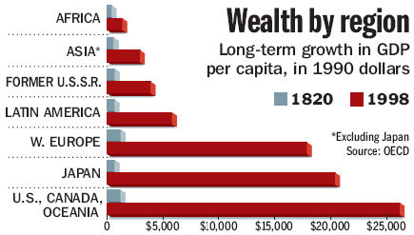
LONG TERM GROWTH IN THE WOLD
Rise of the West accelerated dramatically around 1820 with the industrial revolution
Notes:
Angus Maddison, the world’s leading student of long-term economic development and the Henry Wendt Visiting Scholar at AEI this spring, addresses that question in his new book, The World Economy: A Millennial Perspective (Organization for Economic Cooperation and Development).
Angus Maddison (6 December 1926 – 24 April 2010) was a British economist^{[1]} specialising in quantitative macroeconomic history, including the measurement and analysis of economic growth and development. He was Emeritus Professor at the Faculty of Economics at the University of Groningen (RUG).

Slide 6
THE SECOND TECTONIC SHIFT: RISE OF THE US
Started at the closing years of the 19th century.
Then in the closing years of World War II its dominance is unrivaled
Notes:
In the closing years of the nineteenth century, the United States became the most powerful nation since imperial Rome
For most of the last century, the US has dominated global economics, politics, science and culture
Since World War II that dominance has been unrivaled, unprecedented in modern history. We started the cold war immediately after world war II

Slide 7
SINCE WORD WAR II: US DOMINANce unrivaled
In the closing years of the nineteenth century, the United States became the most powerful nation since imperial Rome
For most of the last century, the US has dominated global economics, politics, science and culture
Since World War II that dominance has been unrivaled, unprecedented in modern history.

Slide 8
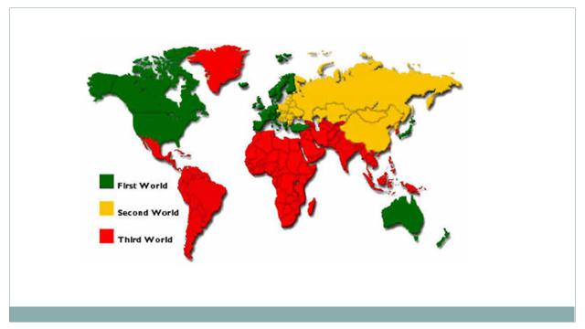
THE WORLD ECONOMIC ORDER DURING THE COLD WAR DOMINATED BY THE USA
ECONOMIC POWER CONCENTRATED IN THE USA AND WESTERN EUROPE
COMMUNIST EASTERN EUROPE AND CHINA IN ISOLATION
THIRD WORLD WERE INTEGRATED IN WORLD ECONOMY THEY NEITHER MANAGED NOR CONTROLLED
Notes:
The Bretton Woods Conference, July 1944, was the gathering of 44 Allied nations in Bretton Woods, New Hampshire USA to regulate the international monetary and financial order at the conclusion of World War II.
The General Agreement on Tariffs and Trade were signed and the conference established the World Bank and the IMF, ALL OPERATING OUTSIDE THE UNITED NATIONS
The World Bank was the IBRD
The General Agreement on Tariffs and Trade (GATT)
Signed in 1947 – Governed international trade relations until 1995 when WTO created
Rules and accomplishments
Most favored nation status for most countries
A tariff cut for one was a tariff cut for all
By 1970s, tariffs had dropped from an average of around 50% to the single digits…Trade exploded.

Slide 9
BRETTON WOODS IN JULY 1944
WORLD BANK
IMF
GATT
Notes:
The Bretton Woods Conference, July 1944, was the gathering of 44 Allied nations in Bretton Woods, New Hampshire USA to regulate the international monetary and financial order at the conclusion of World War II.
The General Agreement on Tariffs and Trade were signed and the conference established the World Bank and the IMF, ALL OPERATING OUTSIDE THE UNITED NATIONS
The World Bank was the IBRD
The General Agreement on Tariffs and Trade (GATT)
Signed in 1947 – Governed international trade relations until 1995 when WTO created
Rules and accomplishments
Most favored nation status for most countries
A tariff cut for one was a tariff cut for all
By 1970s, tariffs had dropped from an average of around 50% to the single digits…Trade exploded.
The United States has been the dominant power in the IMF as well as the World Bank and the GATT/WTO
International Bank for Reconstruction and Development (IBRB) later known as the World Bank
The international Monetary Fund )IMF)
The International Trade Organization (ITO) which came into being only as the General Agreement on Tariff and Trade (GATT) which only much later became the WTO The World Trade Organization )
The United States has been the dominant power in the IMF as well as the World Bank and the GATT/WTO.
In the several financial crises that have afflicted the international economy, the 1994-95 Mexican crisis and the post 1997 East Asian crisis, The US in effect dictated IMF responses

Slide 10
THIRD TECTONIC SHIFT: the RISE OF china
SINCE THE 1980S UNTIL TODAY
Notes:
IN THE THIRD TECTONIC SHIFT, AT THE POLITICO MILITARY LEVEL WE REMAIN IN THE ORBIT OF A DOMINANT USA
BUT IN EVERY OTHER DIMENSION,INDUSTRIAL, FINANCIAL, EDUCATIONAL, SOCIAL AND CULTURAL THE DISTRIBUTION OF POWER IS MOVING AWAY FROM AMERICAN DOMINANCE, NOT TO AN ANTI AMERICAN BUT A POST AMERICAN WORLD

Slide 11
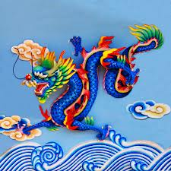
CHINA, THE AWAKENING DRAGON
IN THE OLD DAYS CHINA WAS VERY BIG BUT ALSO VERY POOR and fast sleep for many centuries
TODAY CHINA HAS AWAKENED AND CHINA’S AWAKENING IS RESHAPING THE GLOBAL POLITICAL AND ECONOMIC LANDSCAPE

Slide 12
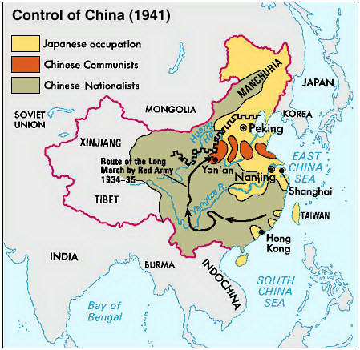
DURING WORLD WAR II

Slide 13
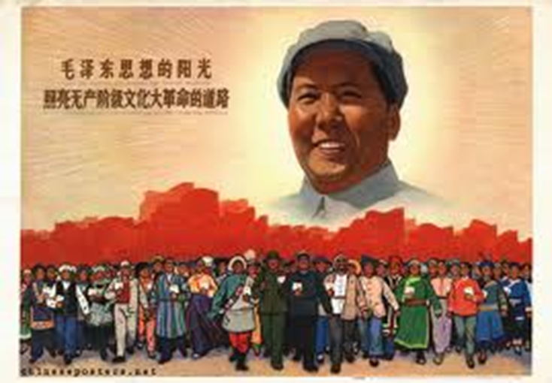
MAO ZHE DONG ESTABLISHED THE PEOPLES REPUBLIC OF CHINA OCTOBER 1 1949

Slide 14
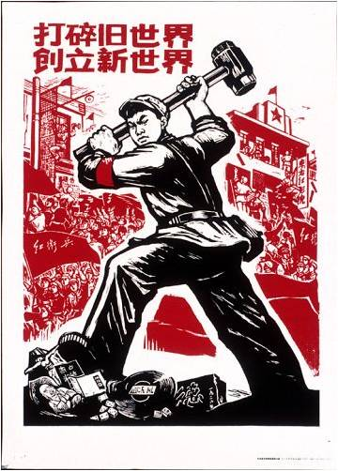
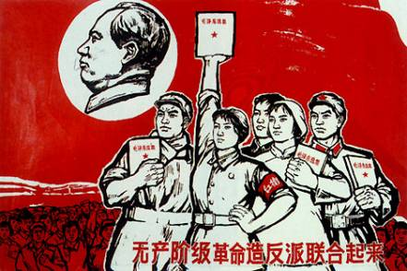
The Great Proletarian cultural revolution 1966-1976
Notes:
Red Guards (simplified Chinese: 红卫兵; traditional Chinese: 紅衛兵; pinyin: Hóng Wèi Bīng) were a mass movement of civilians, mostly students and other young people in China, who were mobilized by Mao Zedong in 1966 and 1967, during the Cultural Revolution 1966 1976.

Slide 15
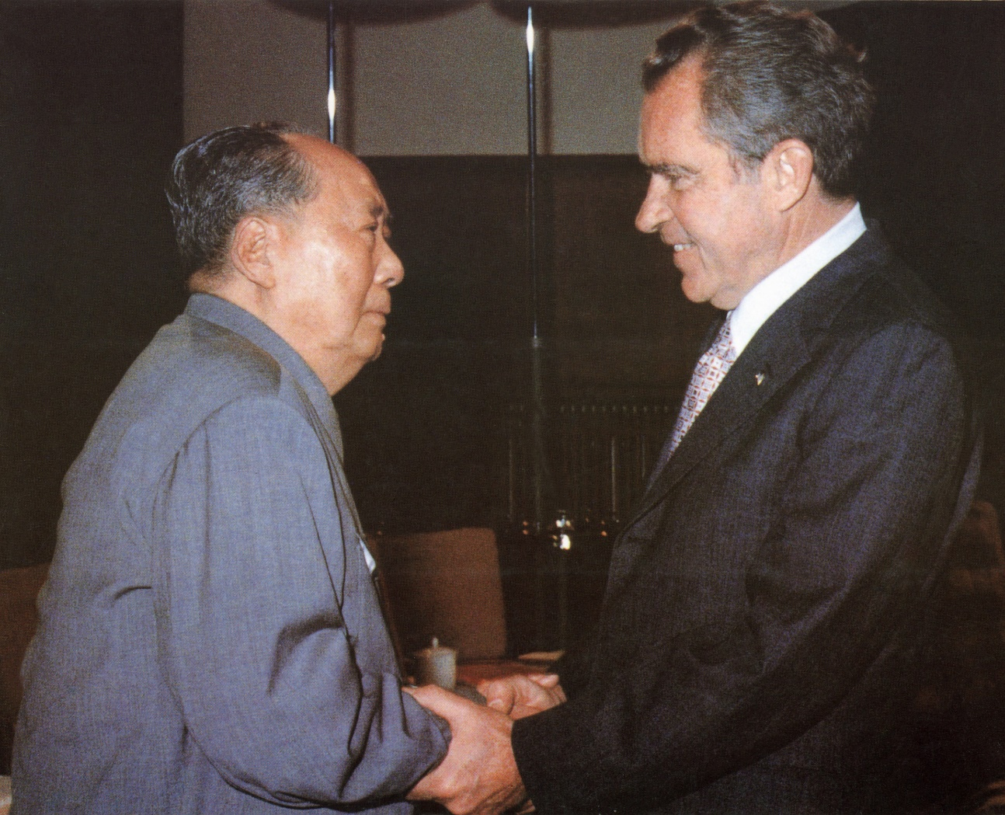
Opening to China: Nixon (and Kissinger) with Mao 1972
Nixon went to China in 1972 to persuade China that it must change
Nixon engineered an “Opening to China” that promised to turn the communist giant into a diplomatic partner, adopt America’s values and maybe even adopt its system of democracy

Slide 16
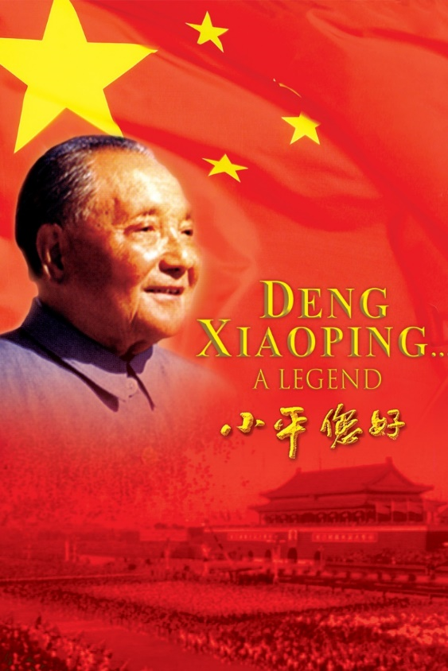
GAIGE KAIFANG 改革开放 reform and opening up
MAO DIED in 1976. I WAS IN CHINA IN 1978
DENG XIAO PING STRUCK THE PRAGMATIC BALANCE BETWEEN THE OPPORTUNITIES OF ECONOMIC ENGAGEMENT WITH THE WEST AND THE DANGERS IMPOSED BY AN INFLUX OF WESTERN IDEAS
FOR ALMOSY 30 YEARS, CHINA’S ECONOMY WAS GROWING AT NEARLY 10% A YEAR, UNMATCHED IN MODERN ECONOMIC HISTORY .
MORE THAN TWELVEFOLD INCREASE IN GDP SINCE 1978

Slide 17
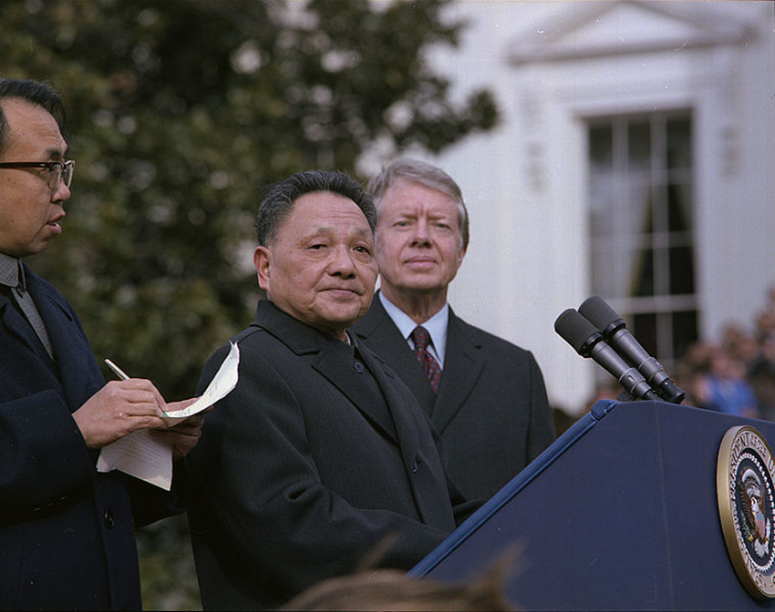
CARTER STARTED DIPLOMATIC RELATIONS IN 1979
AS A RESULT CHINA BECAME THE WORD’S SECOND LARGEST ECONOMY TOPPING JAPAN
JIMMY CARTER STARTED DIPLOMATIC RELATIONS WITH DENGXIAOPING IN 1979

Slide 18
CHINA’S SPECTACULAR ECONOMIC GROWTH
1) Export oriented manufacturing: greatly assisted by outsourcing of jobs by American and European MNCs to China
2) construction: massive urbanization and infrastructure expenditures by the government
Notes:
IN THE EVOLUTION OF ECONOMIC GLOBALIZATION, THE US INDUSTRY HAS SHIFTED WITH LOW COST MANUFACTURING TO CHINA,
China ‘s urban population has risen more than 700 m. as big as USA and three UKs. By 2013 it is expected that 1 billion people will live in citeis in China.
China bullet train with velocity of 300 kph now has a network spanning the entire county and it dit noge xis six years ago, By 2020 every city with a population of 500,000 or more will be connected to it.

Slide 19
SPECIAL ECONOMIC ZONES (SEZ)’S THE BACKBONE OF EARLY INDUSTRIALIZATION
China’s EPZs began as four Special Economic Zones (SEZs) in Shenzhen, Zhuhai, Shantou and Xiamen in 1980 and later expanded to 14 open coastal cities . The entire Hainan Province became the fifth SEZ in 1985
Abundant low-cost labor – most estimates suggest several hundred million peasants migrated to the export-processing zones
Foreign companies (US and Europe) operate in joint ventures in these EPZs.
Little or no regulation – free to pollute, misuse labor, etc.
Currency manipulation (Yuan/remnibi kept very low, 40% below market value)
Innovative workforce and management that quickly duplicates western products that are successful

Slide 20
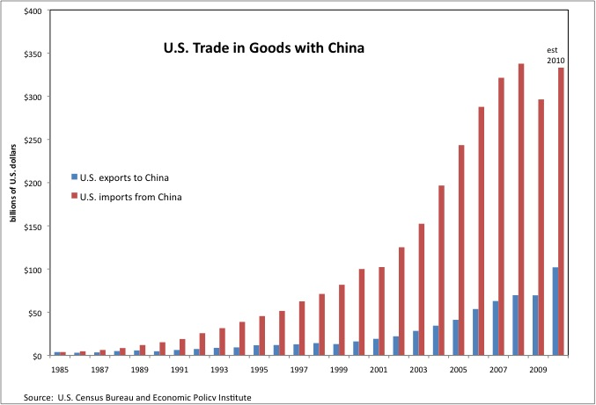
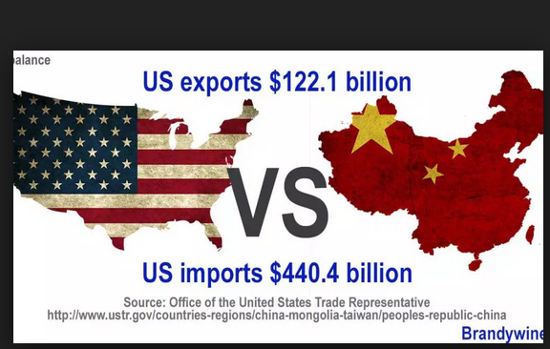

Slide 21
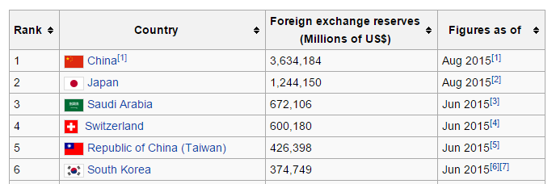
NEW CHINA’S MAGIC FIGURE: $3,634,184
Notes:
China has been generally cooperative with and supportive of the Bretton Woods institutions. At the same time, it is frustrated that existing multilateral institutions limit its global ambitions. The slow pace of reforms at the Western-dominated IMF and World Bank prevents China and other emerging economies from playing a greater role in international

Slide 22
Reduction of poverty in China
Between 1981 and 2008, the proportion of China's population living on less than $1.25/day is estimated to have fallen from 85% to 13.1%, meaning that roughly 600 million people were taken out of poverty
In textiles China’s factory pay has soared by 14% annually, to $700 a month today, compared to $250 in Vietnam, $130 in Cambodia, $110 in Myanmar, and $140 in Laos

Slide 23
URBANIZATION ON A MASSIVE SCALE
Breakneck urban growth has propelled China’s rise in the past three decades. Migration from the countryside has helped expand the urban population by 700 million —the biggest movement of humanity the planet has seen in such a short time.
Of the 30 cities worldwide with population of more than 10 million , six are in China: Shanghai (23m), Beijing (19.5m), Chongqing (13m), Guangzhou (12m), Shenzhen (11m) and Tianjin (11m).
Most of China’s cities share the legacy of a central-planning mindset in which all life and work was centered on a single “work unit”. Their planning focus was on industry; not commerce, services or even community. But in the suburb empty luxury apartments can be seen everywhere

Slide 24
Usa versus china

Slide 25
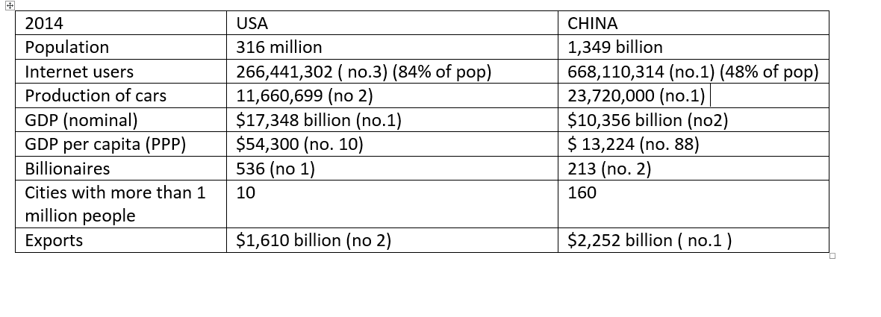
USA VERSUS CHINA 2014
Notes:
CHINA $17.632 B or 16.48% and USA $17.416 B or 16.28% GLOBAL GDP IN PPP

Slide 26
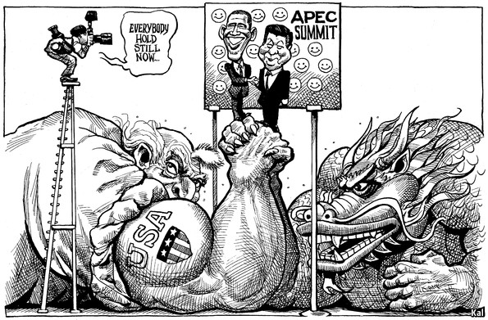
BALANCE OF POWER SEETHING WITH RIVALRY AND INSEUCURITY
UNFORTUNATELY PAX AMERICANA IN SECOND TECTONIC SHIFT IS GIVING WAY TO A BALANCE OF POWER THAT IS SEETHING WITH RIVALRY AND INSECURITY
EVERYWHERE CHINA SEES AMERICAN PLOTS DESIGNED TO PREVENT ITS RISE
IN AMERICA DEMONIZING CHINA IN THE LAST FEW YEARS BECOMES MORE COMMON EVERYDAY
Notes:
APEC SUMMIT FIVE BULLET POINTS BY KEVIN RUDD AN AUSTRALIAN Expert: to contain it, to diminish it, internally to divide it and sabotage its political leadership

Slide 27
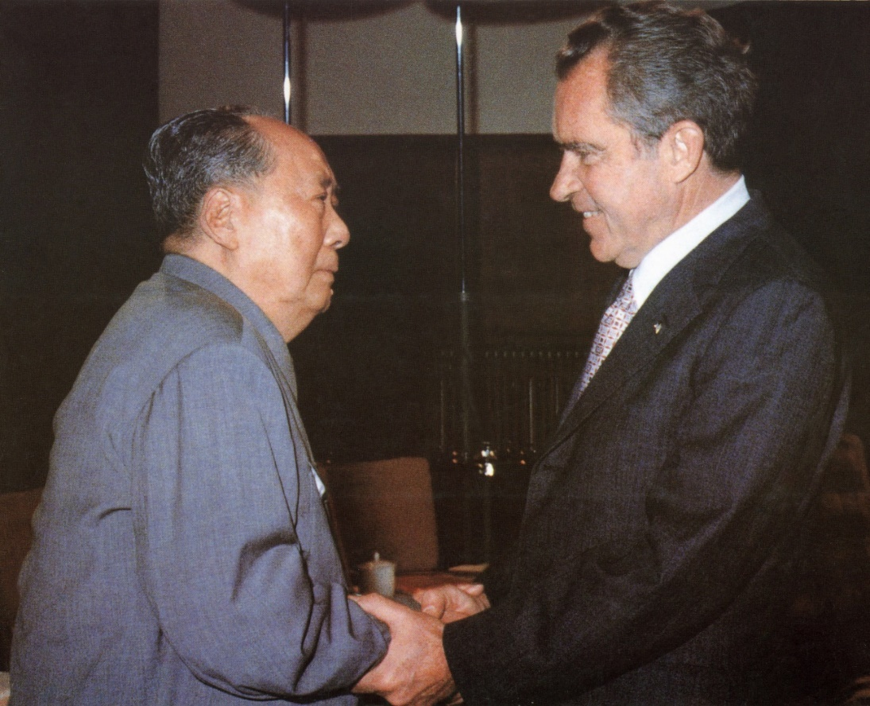
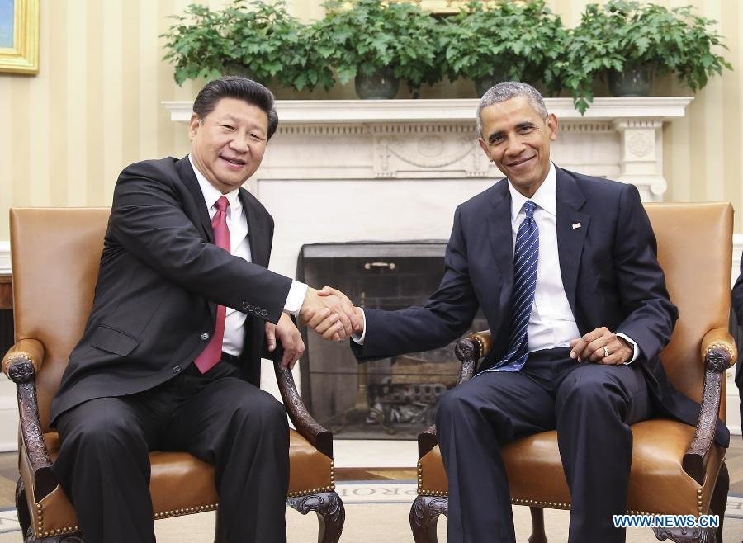
NIXON AND MAOZEDONG IN 1972
OBAMA AND XIJINPING 2015

Slide 28

OBAMA’S LAVISH STATE DINNER
FOR XIJINPING 9-25-2015
After dinner guests were entertained by Ne Yo who also has many fans in China
The 200 –plus guest list of President Barack Obama's lavish state dinner for Chinese President Xi Jinping was a heavy mashup of Hollywood, Diplomacy and corporate chieftains
It was supposed to be the social release after a long day of business. The head table told a different tale — bulging with the top brass from Apple, Microsoft, Facebook, Disney, DreamWorks and more
Guest chef Anita Lo, owner of Annisa in New York created a menu that highlighted "American cuisine with nuances of Chinese flavor: wild mushroom soup, poached Maine lobster, grilled cannon of Colorado lamb
Notes:
After the dinner, guests were to be entertained by the singer Ne-Yo. But much of the Chinese delegation was to miss the entertainment because of a flight to New York that was scheduled to leave around 10 p.m.

Slide 29
XIJINPING STOPPED OVER IN SEATTLE
There Xijingping was, at the head of a bright Westin hotel in Seattle facing down 30 powerful chief executives, talking about his country's economy in glowing terms, downplaying the difficulties China poses to American industry — things like cyberstalking, a volatile stock market, onerous regulations.
To his right were Jeffrey Bezos, head of Amazon, worth $34.8 billion, No. 15 on the list; and investor Warren Buffett, worth $72.7 billion, No. 3. To his left sat Jack Ma, head of the Chinese Internet giant Alibaba Group, $22.7 billion, No. 33; and Ma Huateng, founder of the Internet services company Tencent Inc., $16 billion, No. 56.
The rest of the 30 chief executives gathered were no slouches either: Apple Inc.'s Timothy Cook and Microsoft Corp.'s Satya Nadella, Howard Schultz from Starbucks and Zhang Yaqin, head of Baidu Inc., China's answer to Google.

Slide 30
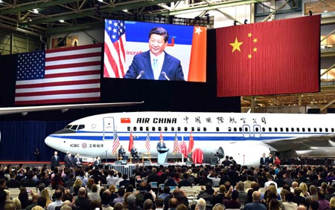
XIJINPING ORDERED 300 BOEING AIRCRAFT
Xi toured Boeing's factory at Everett, and the company announced orders and commitments for 300 aircraft to Chinese customers. The list price for the planes is about $38 billion. China will need 6,330 new airplanes over next 20 years,
And in a move that pleased the Chinese government but infuriated Boeing's union workers, the aerospace giant also announced that it would open a facility in China — its first — to finish aircraft destined for Chinese customers.
The new joint venture will not manufacture any aviation components, Boeing said, but rather workers there would complete plane interiors, paint and deliver aircraft to Chinese buyers.

Slide 31
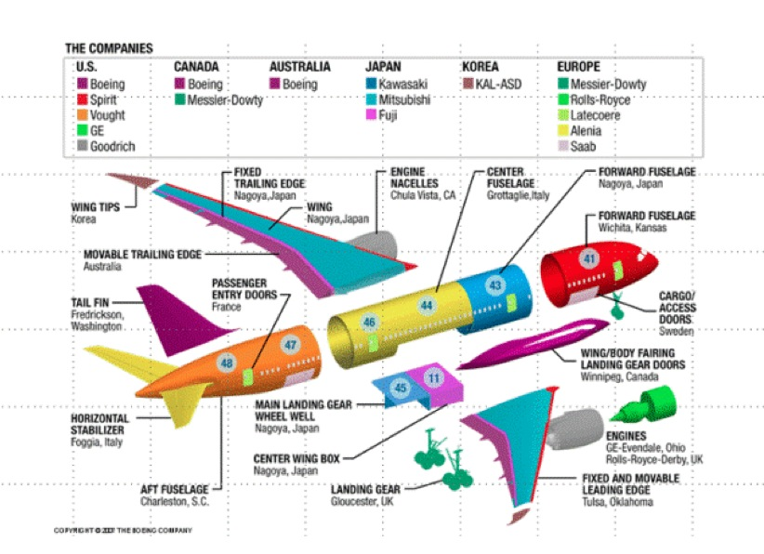
Source: Hausmann

Slide 32
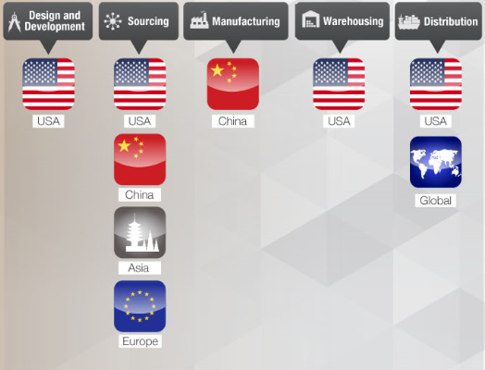
APPLE SUPPLY CHAIN (content and design?)

Slide 33
APPLE: Example of Global Value Chains
The case of iPod (Linden et al, 2009), iPhone (Xing and Detert, 2010), iPad (Linden et al, 2011) show that most components are imported from outside China. The value added made in China through the assembly process only contribute small part of the final value of the products.
For 10 ipods
Source: OECD and WTO

Slide 34
APPLE EMPLOYS one milliOn in china
LOW WAGES IN CHINA COMPARED TO USA
BETTER SKILLED WORKERS THAN USA BECAUSE OF EDUCATION SYSTEM

Slide 35
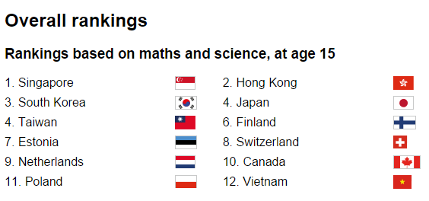
ASIA LEADING AFRICA BOTTOM
The biggest ever global school rankings have been published, with Asian countries in the top five places and African countries at the bottom. The UK is in 20th place, among higher achieving European countries, with the US in 28th.
Notes:
One in five British students leave school without acquiring basic skills, according to a new report commissioned by the Organisation for Economic Co-operation and Development (OECD).
The report, titled 'Universal Basic Skills: What countries stand to gain', was produced by economists Eric Hanushek and Ludger Woessmann.

Slide 36
THE SOUTH CHINA SEA DISPUTE AND ASEAN

Slide 37
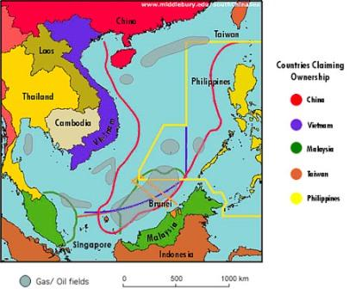
China claims most of the potentially energy-rich sea, through which $5 trillion in ship-borne trade passes every year, and rejects the rival claims of Vietnam, the Philippines, Brunei, Malaysia and Taiwan.
But China rejects U.S. involvement in the dispute, and its more assertive approach recently, including land reclamation and construction on disputed reefs, has stirred tension.
Notes:
To understand the origin of the problem, the U.S. should be aware of its own responsibility in creating this tangled skein. The current SCS scramble can be traced to the San Francisco Peace Treaty (SFPT) of 1951. At that time, Treaty designer John Foster Dulles purposefully left Asian frontier territories without owners. As pointed out by Kimie Hara, author of the Cold War Frontiers in the Asia-Pacific, the Treaty originated most of Asia’s territorial mess. Remember, neither of the Chinese governments were allowed to take part these deliberations. The South China Sea disputes are just two in the long list of flare-ups from northeast to southeast Asia, including the Kurile Islands/Northern Territories, a divided North-South Korea, and the Dokdo/Takeshima Islands, as well as the Senkaku/Diaoyu Islands, Taiwan itself, the Paracels/Xisha, and the Spratlys/Nansha Islands.

Slide 38
The U.S. should be aware of its own responsibility in creating this tangled mess. The current SCS scramble can be traced to the San Francisco Peace Treaty (SFPT) of 1951. At that time, Treaty designer John Foster Dulles purposefully left Asian frontier territories without owners and the Treaty originated most of Asia’s territorial mess.
Neither of the Chinese governments were allowed to take part in these deliberations. The South China Sea disputes are just two in the long list of flare-ups from northeast to southeast Asia, including the Kurile Islands/Northern Territories, a divided North-South Korea, and the Dokdo/Takeshima Islands, as well as the Senkaku/Diaoyu Islands, Taiwan itself, the Paracels/Xisha, and the Spratlys/Nansha Islands.

Slide 39
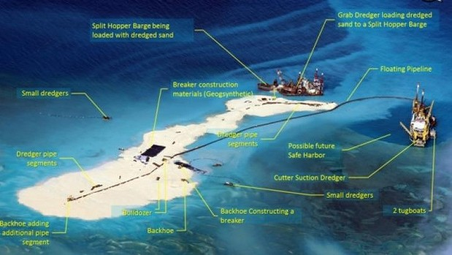
Today the size of these reef-based constructions has grown from a total area of 5 acres to about 2,000 acres, a 400-fold increase in acreage
Fitzgerald destroyer within twelve nautical miles
$25o million aid announced by Obama in Manila during the APEC summit

Slide 40
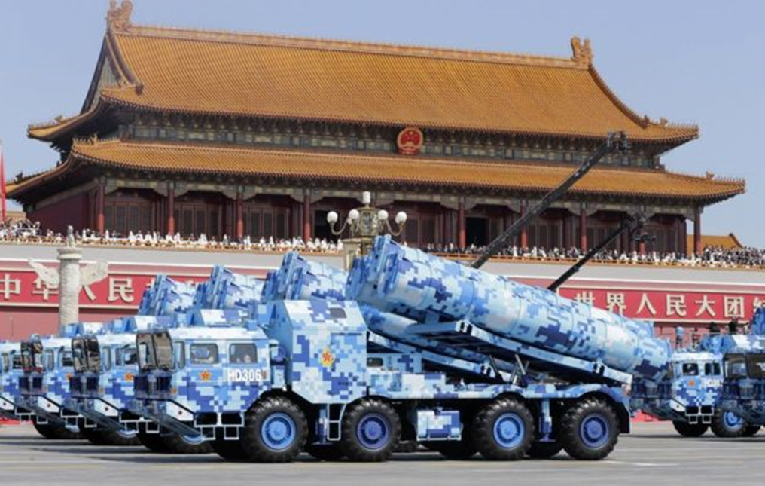
CHINESE V DAY PARADE 9-3-2015
More than 30 foreign government officials and heads of state including Russia's President Vladimir Putin, Cambodian King Sihamoni and UN Secretary General Ban Ki-moon attended the event.
Some 12,000 troops and 200 aircraft, as well as tanks and missiles, were on display in Tiananmen Square, including the anti-ship "carrier killer" missile Dongfeng-21D

Slide 41
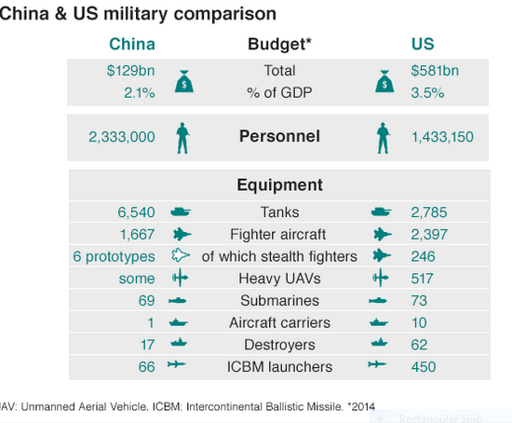

Slide 42
Obama AND XIJINPING AT THREE SUMMITS in November 2015: g20, apec AND asean

Slide 43
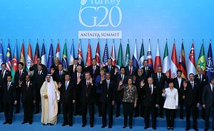
GROUP OF 20 SUMMIT AT ANTALYA TURKEY
GROUP OF SEVEN COUNTRIES: USA, CANADA,FRANCE, UK, GERMANY,ITALY AND JAPAN 7
GROUP OF TWENTY : GROUP OF SEVEN PLUS ARGENITNA, MEXICO, AUSTRALIA,BRAZUL,CHINA,INDIA, INDOENSIA, SOUTH KOREA, SAUDI ARABIA, SOTH AFRICA, MEXICO,TURKEY

Slide 44
THE APEC SUMMIT IN MANILA PHILIPPINES
U.S. efforts to proactively influence the region’s path toward economic integration are focused on the Trans Pacific Partnership (TPP) which was spawned by concerns that the United States could be left out of an emerging, highly-integrated and rapidly growing Asian economy
The Trans-Pacific Partnership, or TPP, is a trade and investment agreement that has been entered into by twelve Pacific Rim countries: Australia, the United States, Brunei, Canada, Chile, Japan, Malaysia, Mexico, New Zealand, Peru, Singapore and Vietnam.

Slide 45
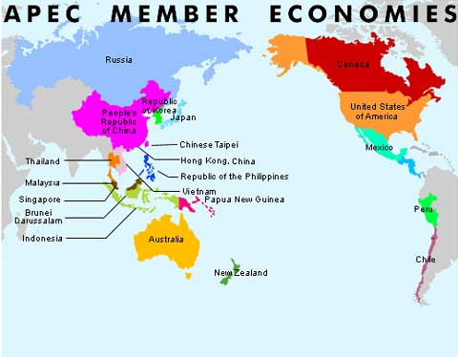
THE APEC SUMMIT IN MANILA PHILIPPINES
APEC has 21 member economies bordering on the Pacific Ocean
U.S. efforts to proactively influence the region’s path toward economic integration are focused on the Trans Pacific Partnership (TPP) which was spawned by concerns that the United States could be left out of an emerging, highly-integrated and rapidly growing Asian economy

Slide 46
ASIA PACIFIC ECONOMIC COUNCIL HAS 23 MEMBER ECONOMIES
TPP: Trans Pacific Partnerships : 12 members. Pushed by the USA and excluding China
RCEP: Regional Comprehensive Economic Partnership: 16 members pushed by ASEAN and six dialogue partners excluding USA
Notes:
TPP: 6,000 pages. U.S. efforts to proactively influence the region’s path toward economic integration are focused on the Trans Pacific Partnership (TPP) which was spawned by concerns that the United States could be left out of an emerging, highly-integrated and rapidly growing Asian economy TPP is a free trade agreement between the nine negotiating parties – Australia, Brunei, Chile, Malaysia, New Zealand, Peru, Singapore, the United States, and Vietnam – and will form the basis for a broader agreement
The US has not invited China and China views the TPP, as well as Obama’s pivot towards Asia, as tools to contain it
The ASEAN region is part of the Regional Comprehensive Economic Partnership, which ties ASEAN members into a program of trade liberalization with China, India, South Korea, Japan, Australia and New Zealand.
In addition, the ASEAN states of Malaysia, Singapore, Vietnam and Brunei are founding members of the Transpacific partnership, a recently-agreed trade agreement with the U
At least three motivations seem plausible.
First, to make a big splash in defining the trade agenda by pursuing the most ambitious goal of all: an Asia Pacific trade grouping incorporating both China and the US. Second, to prevent the Trans Pacific Partnership (TPP) from becoming the focal point of economic integration efforts and a reaffirmation of America’s leadership as a Pacific power. And third, for China to carve a much more proactive role in drafting the new rules of the economic order — from a position of equal standing with the United States. Potential entry into the TPP, after it enters into force, would not award China these advantages: China would have to abide by disciplines negotiated by others and would have to make significant concessions to ensure its accession.

Slide 47
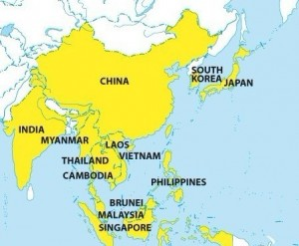
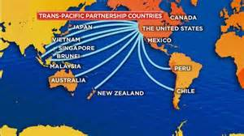
TPP VERSUS RCEP
TPP
RCEP

Slide 48
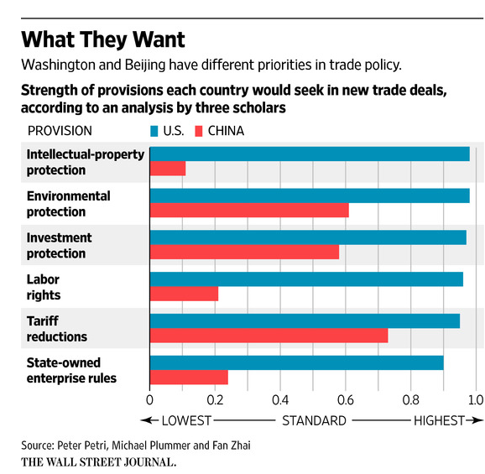

Slide 49
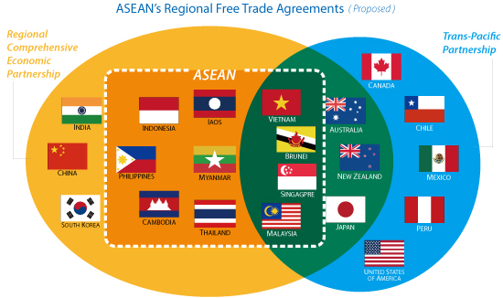
TPP, RCEP
TPP: Trans Pacific Partnerships : 12 members. Pushed by the USA and excluding China
Regional Comprehensive Economic Partnership (RCEP) is a Free Trade Agreement scheme of the 10 ASEAN Member States and its FTA Partners (Australia, China. India, Japan, Korea and New Zealand) to be concluded by the end of 2015

Slide 50
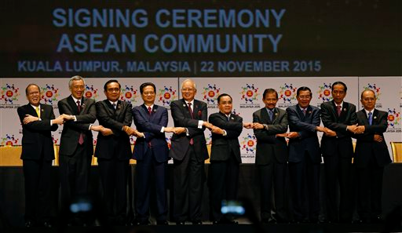
Annual asean summit in kualA LUMPUR MALAYSIA
Obama and Xijinping attended the annual East Asian Summit and Annual ASEAN Summit hosted by Malaysia in Kuala Lumpur Malaysia November 21-23 to declare the ASEAN Economic Community

Slide 51
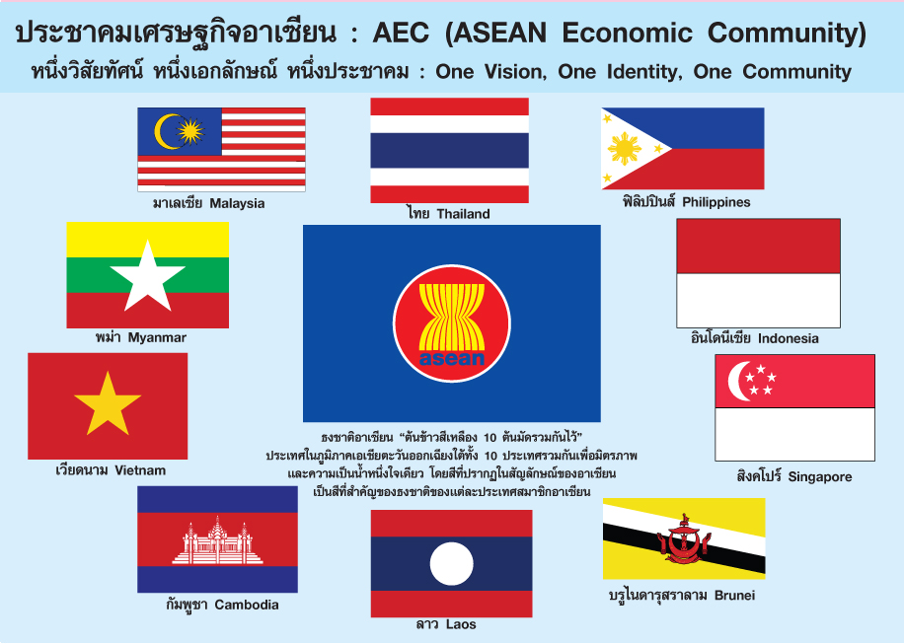
THE ASEAN ECONOMIC COMMUNITY
In Kuala Lumpur, the 10 ASEAN member states signed an official declaration to establish the ASEAN Economic Community (AEC), opening a new chapter in the region's 48-year history.
After more than 13 years of discussion around forming the AEC, the declaration finally comes into effect on December 31 , when the region supposedly turns into a single market and production base.
Notes:
Serious efforts at economic integration among ASEAN six countries started only in 1992. 1992: UNTAC in Cambodia/. Initial obstacles included widespread policies of import substitution. ASEAN united in 1980s to oppose PRK. The switch to outward looking development strategies and external pressures, such as the formation of the European Union Single Market and the North American Free Trade Area (NAFTA) pressured ASEAN to form a free trade area in 1992.
The challenges of globalization, and the economic rise of the People Republic of China and India further pressured ASEAN into deep integration in 2003

Slide 52
TOWARDS AN ASEAN ECONOMIC COMMUNITY IN 2015
Objective of AEC: to transform ASEAN into a single market of 622 million people. with free movement of goods, services, investment, skilled labor, and freer flow of capital
Gross domestic product (GDP) in 2014 was US$2.6 trillion. This is expected to rise to US$4.7t by 2020.
Notes:
In January 2007, leaders of ASEAN adopted a blueprint for the creation of the ASEAN Economic Community (AEC) by 2015
The integration will help increase ASEAN competitiveness with China and India.

Slide 53
One analysts argue that the establishment of the AEC is more of a political move than an economic one - ASEAN seeks to use the AEC to achieve a greater say in regional and global affairs. The RCEP negotiation is a good example of this.
Given, also, the diversity of the region, there is still a lack of ASEAN identity. Without this identity, it is hard to make strong progress.

Slide 54
Intra-regional trade made up about 24 per cent of ASEAN's total global trade for the last decade, ranging from 13.9 per cent in Vietnam to 64.9 per cent in Laos.
With the AEC, intra-regional trade is likely to increase. The statistics for the European Union sit at 60 per cent.
Corruption, uneven infrastructure and related costs, are among the obstacles currently in the way of increased trade within ASEAN.

Slide 55
Trade in services is another key building block in the AEC, which seeks to implement 11 packages of services liberalization, nine of which have been completed, with the two remaining scheduled for this year and next.’
In spite of the slower progress in services trade, the share of services trade as a proportion of the total has risen from 14 per cent in 2006 to 20 per cent in 2015, according to HSB

Slide 56
Indeed, there are several implementation issues, including the “Asean way” which stresses consensus-based decisions and non-interference in the internal affairs of fellow members. The lack of administrative capacity, demonstrated by the fact that the Asean secretariat had an annual budget of just $17m in 2014, creates further headwinds.

Slide 57
What is more, this extremely pervasive and, some would say, blind adherence to the ASEAN way combined with the lack of a robust and sound institutional architecture, have left intact the problem of ensuring compliance and effective implementation of targets by national governments and agencies.
In spite of the various commitments entered into under the AEC, ASEAN is still missing the necessary institutional glue, which could take the form of an overarching regional mechanism that ensures the smooth coordination of the vast

Slide 58
The only aspect of the AEC’s vision that is close to being realized is trade liberalization. As of 2010, some 99 per cent of the items on the inclusion lists of the ASEAN six were free of tariffs. The less developed members — Cambodia, Laos, Myanmar and Vietnam — have been given until 2016 to complete full removal of tariffs.
Significant hope has accompanied the AEC’s formation. Many analysts have pointed out that integrating ASEAN economies would create the world’s seventh-largest single market, and they are certainly right. However, taking advantage of this market requires dealing with its complexities and contradictions, and accommodating the vast differences and national sensibilities.

Slide 59
DEVELOPMENT DIVIDE BETWEEN CLVM AND ASEAN SIX
While much has been achieved in reducing trade barriers, much needs to be done in the area of trade facilitation, and cutting the “red tape” in CLVM countries. For example, procedures for trading are relatively easy to complete in Singapore, Thailand, and Malaysia, but very difficult in Laos and Cambodia.
The quality of logistics services also varies among the two categories of ASEAN members, such as customs brokerage, freight forwarding, and express delivery. Logistics services are world-class in Singapore but poor in Laos, Cambodia, and Myanmar. In many ASEAN countries, restrictive regulations hamper the delivery of high-quality logistics services.

Slide 60
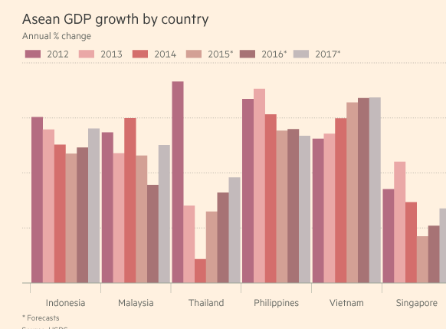

Slide 61
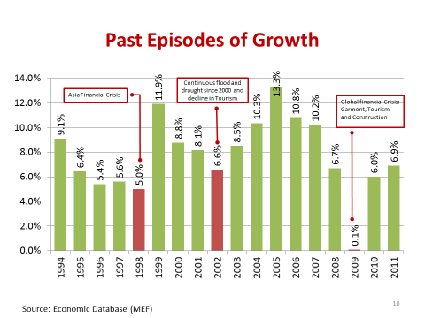
During 1998 and 2013 rapid growth for Cambodia, and during that period its growth was the sixth highest in the world.
This growth has transformed the population, and Cambodia’s poor dropped from 53% to 20% of its total population between 2004 and 2011
Notes:
The decade between 1998 and 2007 was one of rapid growth for Cambodia, and during that period its growth was the sixth highest in the world. Cambodia enjoyed an average growth rate of 8.1% between 2000 and 2012, and the IMF projects Cambodia to have 7.7% growth in 2017. This growth has transformed the population, and Cambodia’s poor dropped from 53% to 20% of its total population between 2004 and 2011

Slide 62
CHINA TOP INVESTOR AND AID GIVER TO CAMBODIA
Loans and grants from China during the period 1992 to 2013 have amounted to $2.7 billion.
From 1994 to 2012, total Chinese investment in Cambodia has reached $ 9.17 billion.
China is also one of the leading trading partners of Cambodia. Last year, bilateral trade volume accounted for $2.9 billion U.S. dollars and it is expected to reach $5 billion by 2017.

Slide 63
THE HARDWARE OF TRADE: OBOR AND AIIB

Slide 64
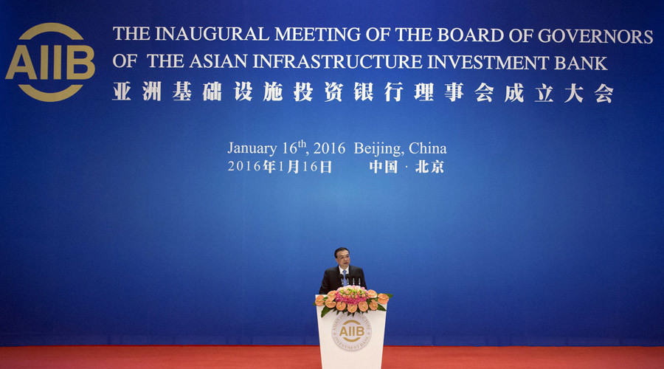
ASIAN INFRASTRUCTURE INVESTMENT BANK (AIIB )
Despite opposition from the USA, on 16 January the AIIB was launched in Beijing with 57 member states including allies of the US such as UK. Korea, Germany and Australia
Notes:
China has been generally cooperative with and supportive of the Bretton Woods institutions. At the same time, it is frustrated that existing multilateral institutions limit its global ambitions. The slow pace of reforms at the Western-dominated IMF and World Bank prevents China and other emerging economies from playing a greater role in international

Slide 65
AIIB IS FURTHER PROOF OF REBALANCING 0F WORLD POWER
AIIB is regarded by some as a rival for the IMF the WORLD BANK and the ASIAN DEVELOPMENT BANK (ADB) which are regarded as dominated by developed countries like the United States
A successful AIIB that sets itself apart from the World Bank and the International Monetary Fund (IMF) would be a diplomatic triumph for China, which opposes a global financial order it says is dominated by the United States and does not adequately represent developing nations.

Slide 66
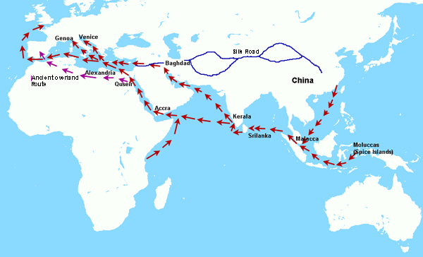
The old silk road being revived by xijinping

Slide 67
ONE BELT ONE ROAD (OBOR)
MARITIME SILK ROAD
(MSR)
SILK ROAD ECONOMIC BELT
(srem)
OBOR(ONE BELT ONE ROAD)

Slide 68
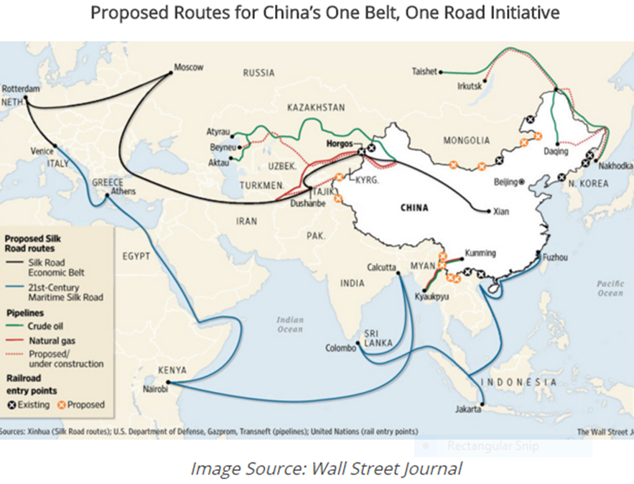

Slide 69
The silk route ECONOMIC BELT (SREB)
Xi Jin Ping president of China is reviving the silk route connecting the Chinese empire to Central Asia, the middle East and even Europe
He proposes a vast network of railroads, pipelines highways and canals to follow the contours of the old silk route
He also considered to built a roughly 8,100 mile high speed intercontinental railroad that would connect China to Canada. Russia and the United States through the Behring strait
Notes:
China has also proposed the “Silk Road Economic Belt” and “21st Century Maritime Silk Road,” or “One Belt, One Road” (OBOR), an even broader and more ambitious initiative. The AIIB will serve as the financing arm of OBOR. The AIIB will begin with authorized capital of $50 billion, eventually to be raised to $100 billion. The projected investment for OBOR will be $1.4 trillion, about 12 times larger than the Marshall Plan, which was about $120 billion in today’s value. In addition to the economic benefits, the AIIB and OBOR will significantly facilitate the movement of goods, services, and people across national borders. Over the past two decades, China has contributed substantially to infrastructure or “hardware” of many developing nations, but it remains short of “software” or soft power. Beijing hopes that its new initiatives with a non-coercive, non-military approach will help enhance its international image as a responsible global power. The AIIB and OBOR have become an integral part of China’s new diplomacy, reflecting its growing interests and clout. They are also important steps to realizing President Xi Jinping’s “Chinese dream.”

Slide 70
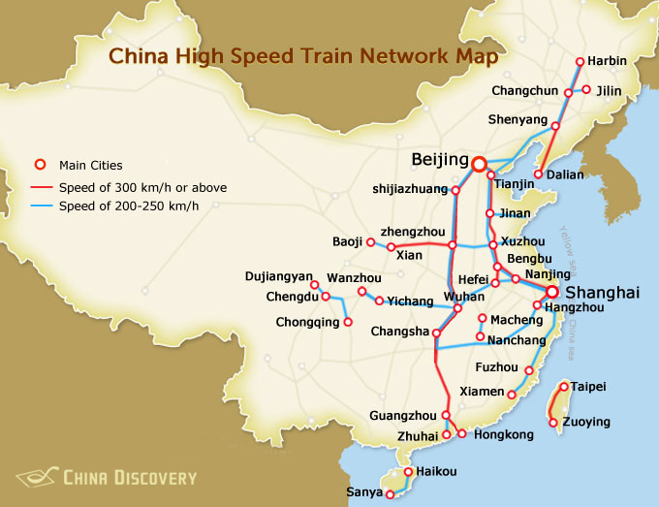
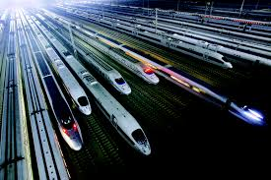
CHINA’S HIGH SPEED RAILWAY NETWORK
China today has the world’s longest High-Speed Railway network with over 16,000 km (9,900 mi) of track as of December 2014, more than the rest of the world’s high speed rail tracks combined. It did not exist eight years ago.
China’s high speed rail system also includes the world’s longest line, the 2,298 km (1,428 mi) Beijing–Guangzhou High-Speed Railway. In short, China knows what it is doing in railways more than pretty much anybody and they are acting on that knowledge

Slide 71
Obor (ONE BELT ONE ROAD)
The projected investment for OBOR will be $1.4 trillion, about 12 times larger than the Marshall Plan, which was about $120 billion in today’s value. In addition to the economic benefits +OBOR will significantly facilitate the movement of goods, services, and people across national borders.
The AIIB and OBOR have become an integral part of China’s new diplomacy, reflecting its growing interests and clout. They are also important steps to realizing President Xi Jinping’s “Chinese dream.”
Notes:
China has been generally cooperative with and supportive of the Bretton Woods institutions. At the same time, it is frustrated that existing multilateral institutions limit its global ambitions. The slow pace of reforms at the Western-dominated IMF and World Bank prevents China and other emerging economies from playing a greater role in international

Slide 72
CHINA TOP INVESTOR AND AID GIVER TO CAMBODIA
Loans and grants from China during the period 1992 to 2013 have amounted to $2.7 billion.
From 1994 to 2012, total Chinese investment in Cambodia has reached $ 9.17 billion.
China is also one of the leading trading partners of Cambodia. Last year, bilateral trade volume accounted for $2.9 billion U.S. dollars and it is expected to reach $5 billion by 2017.

Slide 73
CHINA REBALANCING: FROM INFRASTRUCTURE AND EXPORTS TO DOMESTIC CONSUMPTION

Slide 74

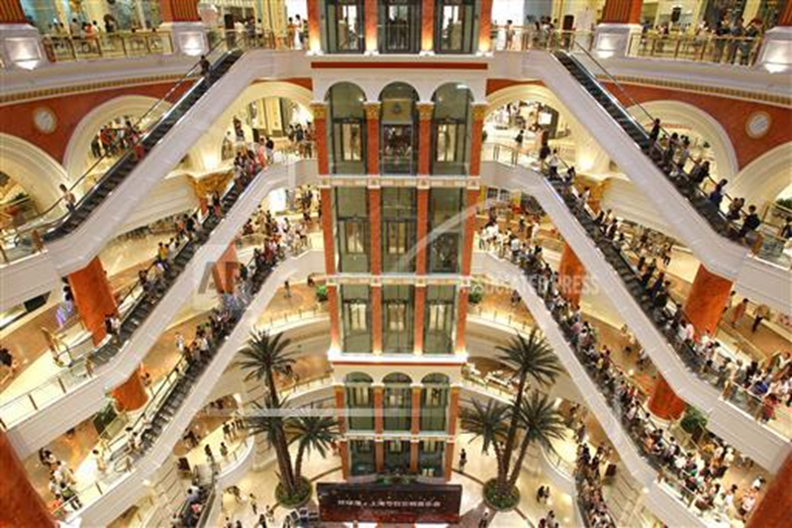
FROM INVESTMENTS AND EXPORTS TO domestic CONSUMPTION
Global harbor shopping mall in Shanghai among the world’s biggest shopping malls with floor space equivalent to nearly 70 football fields
Ford Focus hatch-back at Chongqing auto show
Notes:
Ranks among the world’s largest shopping malls, with floor space equivalent to nearly 70 football fields
China will rely much more heavily on internal demand as it matures – a necessary step to avoid destructive trade conflicts

Slide 75
CONCLUSIONS
In what is the critical bilateral relationship of the 21st century, China should not be seen as a rival superpower to the United States. The US should instead adopt a new paradigm, in which the real challenge lies in dissuading China from regional aggression while encouraging the country to contribute to the global order.

Slide 76
ANY QUESTIONS?

Slide 77
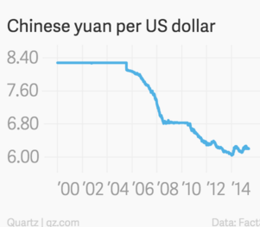
TRUMP’S CURRENCY MANIPULATION ARGUMENT
IS AN OLD STORY
Trump’s accusation is five years outdated
From 2008 to 2010 Yuan steadily increased its value to just 6 to the dollar
From early 2014 to midsummer 2015 yuan declined slightly to 6.20 per dollar
Then in August it shocked the world with a 3% devaluation to 6.38 per dollar

Slide 78
CHINA REBALANCING: FROM INFRASTRUCTURE AND EXPORTS TO DOMESTIC CONSUMPTION

Slide 79
ERA of CREATIVE DESTRUCTION
TRANSFORMATION WOULD MEAN LARGELY SACKING THE TEXISTING MODEL OF INSENSATE STAE CAPITAL SPENDING ON INDUSTRIAL CAPACITY, SPLASHY INFRASCTRUCTE PROJECTS, AND COMMERCIAL AND RESIDENTIAL CONSTRUCTION THAT SPAWNS UNPRODUCTIVE AND REDUNDANT FACTORIES, GHOST CITIES. AND UNNEEDED ROADS, BRIDGES, AIRPORTS, ETC

Slide 80
TO BOOST EFFICENCY AND EFFICIENCY, STATE OWNED ENTERPRISES THAT DOMINATE MANY ECONOMIC SECTORS, MUST BE BROKEN UP AND MAYBE PARTLY PRIVATCIZED
EXPERTS FORESEE THAT THE EOCONOMY WILL BE FAR WORSE IN 2016 THAN IN 2015

Slide 81
CONSUMER MAIN IMPEDIMENT
WORLD BANK ESTIMATES THAT CONSUMPTION SPENDING IN CHINA AS PERCENTAGE OF GDP IS BELOW 40%, VERSUS 55% IN GERMANY AND 68% IN THE USA
WEALTH IS SO CONCENTRATED THAT THE SUPERRICH HAVE MORE MONEY THAN THEY CAN SPEND
A TRUE MIDDLE CLASS, IN THE WESTERN SENSE OF THE WORD, DOES NOT EXIST. AT LEAST NOT TO THE DEGREE IT EXISTS IN THE USA OR WESTERN EUROPE
ANTI CORRUPTION DRIVE ALSO SLOWS DOWN CONSUMER SPENDING ON JUNKETS TO MACAO JEWELLERY AND EXPENSIVE CARS

Slide 82
Security will be another major challenge. For example, as part of OBOR, China will build 81,000 kilometers (about 50,000 miles) of high-speed railway, more than the current world total, involving 65 countries. Who is going to protect so many projects covering so many countries? The Kashgar-Gwadar economic corridor links western China and Pakistan with roads and pipelines and will send electricity to Pakistan. The route passes through some of the world’s most vulnerable and conflict-ridden territory.

Slide 83
The AIIB aims to be a new multilateral financial institution designed to provide financial support for infrastructure development and regional connectivity in Asia.
It will also promote regional cooperation and partnership in addressing development challenges. The AIIB was launched with US$100 billion in capital, and is expected to lend US$10 to 15 billion a year for the first five or six years

